Slide 1


Limited transit data, No Travel Model…no problem!
Rhett Fussell, PE
Senior Vice President
Management Consultancy, Systems Analysis Group
A journey to estimate transit ridership with Big Data and Machine Learning
Notes:
Transit investments can be impactful for smaller cities. They spur local development and improve citizens access to the region. However, estimation of the ridership for a new station along an existing line can be challenging when travel models are not readily available, no access to existing ridership data is allowed and you need results within four months.
This presentation explains how Palm Beach Gardens was able to estimate ridership potential on Brightline for their city using big data and machine learning, thus allowing the City to feel confident in the station being feasible.

Slide 2

Special Thanks
Shivang Shelat And Behzad Karimi
the smart people that did the work
Lori LaVerriere, Deputy City Manager & Staff
The City of Palm Beach Gardens
Disclaimer: Project Completed before Rhett Began to Manage Brightline Florida
Thanks SF- Nothing to do with this presentation…. but fantastic if you are a transit dork & baseball fan.

Slide 3
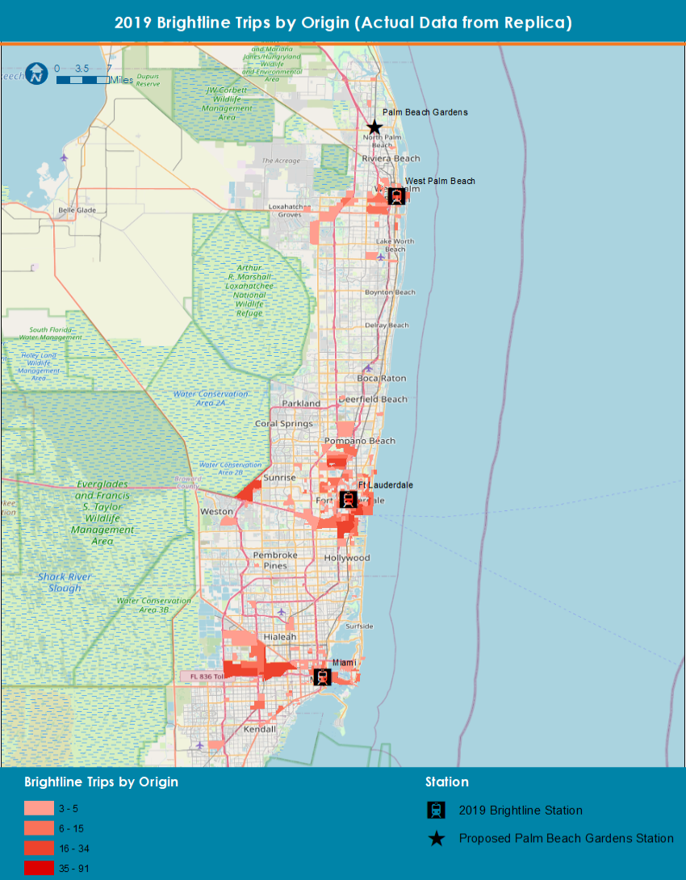
project description
Brightline – Private inter-city train service between Miami and Orlando
The City of Palm Beach Gardens wanted a Brightline station in the City.
Main goal of the project was to estimate potential boardings at a hypothetical Palm Beach Gardens station.

Slide 4
project challenge
Unable to use Brightline’s proprietary model, or information such as station to station movements, actual boarding counts, fare sensitivity or rider information.
Unable to use STOPS model because of the short duration of the study (4 months)
A different methodology that relied upon Replica Data and machine learning was developed to estimate the feasibility of the station.
Model replicates existing conditions
Not sensitive to fares, schedules, frequency, does not predict ‘future year’ scenarios
First ever attempt at this…..be nice to us!
Aventura and Boca Raton opened in late 2022 and Orlando opened in late 2023. Replica data was from 2019 and wasn’t available for these stations.
Notes:
One condition brightline imposed was that the City cannot use Brightline’s proprietary model for this purpose. So we couldn’t get station to station movements, fare sensitivity, etc.
Couldn’t use STOPS model because the study was supposed to be completed in 4 months
Who here has heard of Replica?
Replica Data is a large, national dataset that provides disaggregated data for interactions between people, land use, mobility, and economic activity.
We used select output from Replica and used it to train the model.
Because the model was trained using existing data, it is not sensitive to any fare, schedule, capacity changes in the Brightline service.
Another key point is that the data we used was from 2019 (pre-pandemic). So there was no data for Boca or Aventura since they opened in 2022.
With that out of the way… what exactly did we do?

Slide 5
methodology
The basic premise of the model is to leverage select trip characteristics of existing Brightline trips to estimate boardings on Palm Beach Gardens station
Our initial analysis suggested that the strongest correlation between ridership from a CBG are for the following factors
Number and type of dwelling units (SF, MF, MU)
Building area by land use
SFR, MFR, MU, Commercial, Retail, Education, etc. – 14 types
Driving distance from the CBG centroid to nearest station
Whether the CBG contains airport or a major mall
Notes:
The city also wanted to test out a ‘build’ scenario where all the high density development currently under construction or approved will be taken into consideration
Land use, building use, and trip production data was aggregated to the census block groups.
We focused on number and type of dwelling units, building area by land use, driving distance from the census block group to the nearest station, whether it contains an airport or major mall.
Building area was used as a proxy for population and employment in this method
Distance to nearest station was calculated using an R script and Open Street Maps data

Slide 6
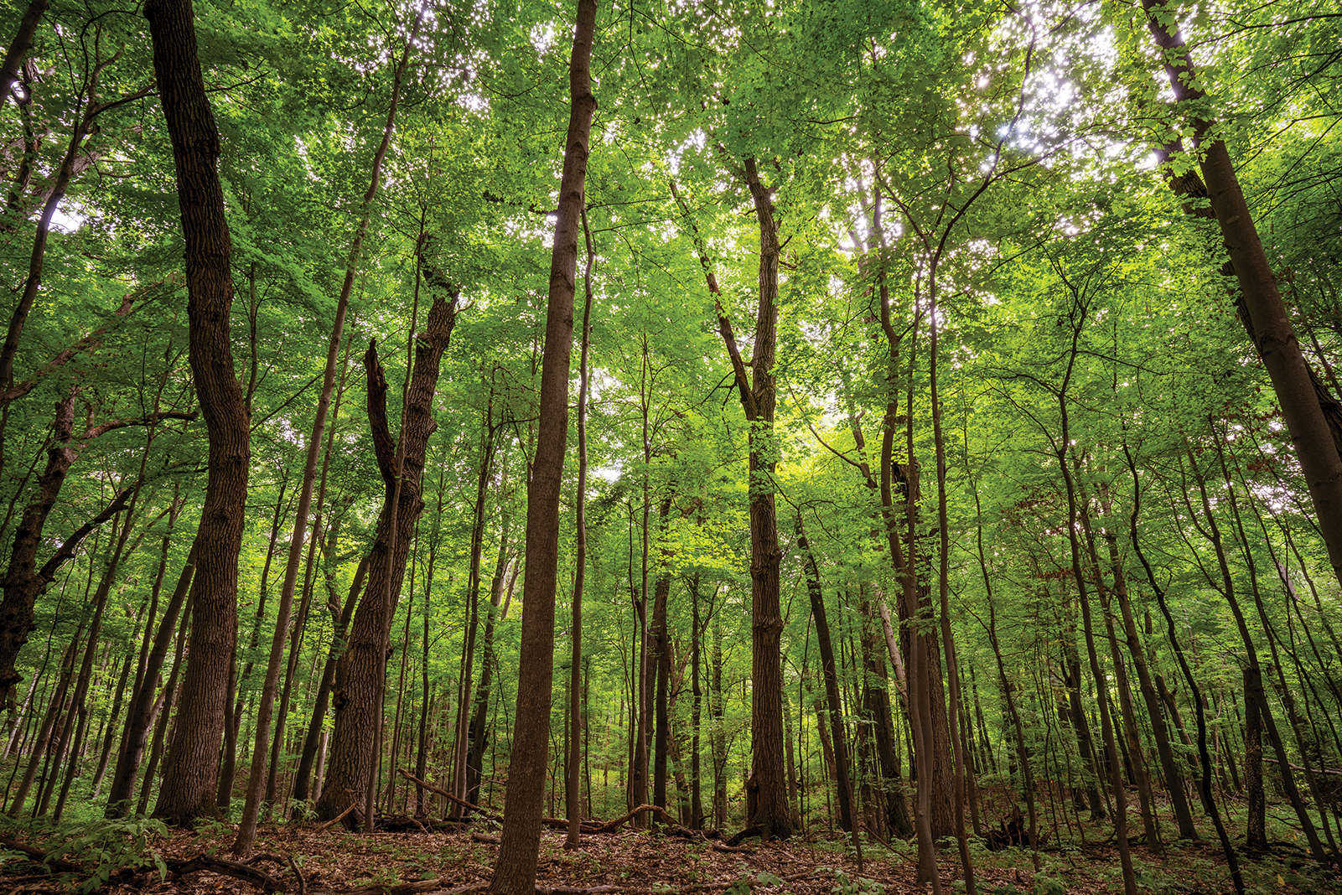
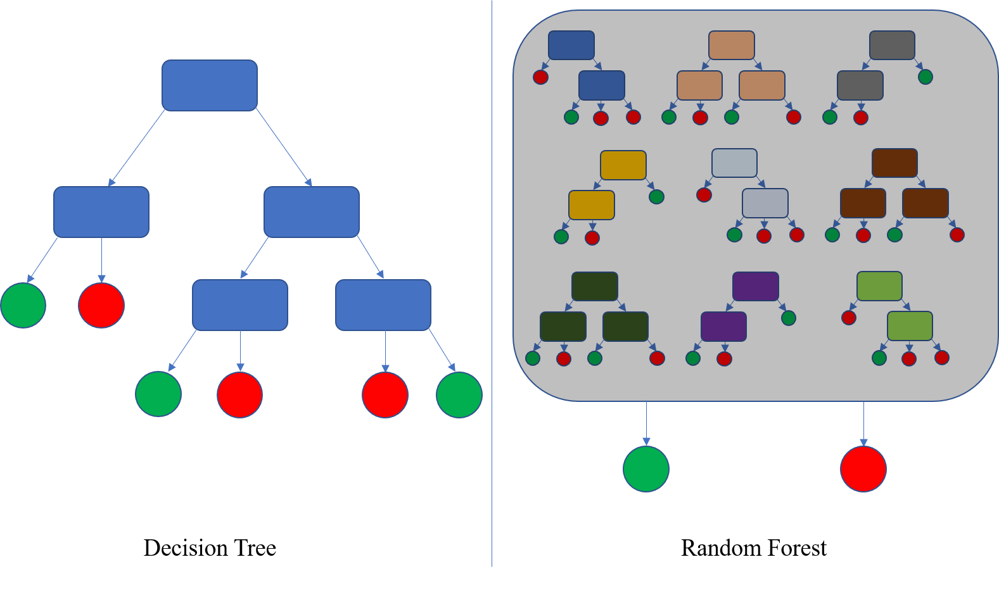
methodology
We looked at various methods for estimation…but lack of data ya know
Decided on using Machine Learning
Usually outperforms standard econometric methods
Works well on large datasets, and
Successful with missing data by creating estimates for them
Fast and needs less input data preparation
Chose Random Forest
harness the simplicity of Decision Trees and the power of “ensemble methods”
Decision tree on steroids
Notes:
No this is not a forest you have never been to like this Fish Lake for Minnesota’s first memorial forest—a living cemetery where trees stand in place of headstones. When people die and are cremated, their families bring their ashes to the forest to be mixed with local soil and spread around the base of their chosen tree. The cremains break down over time into their component nutrients of calcium and phosphorus, which feed the forest.
The result is a model that is significantly more accurate.
Build a decision tree using a random subset of the available variable at each step
This is typically repeated over 100 times resulting in a “random forest” of decision trees that vary based on the data and variables they saw.

Slide 7
Methodology: feed me data
Preparing the training dataset for the model using the selected trip features.
What is the model seeing?
 | Min | 1st Quarter | Median | Mean | 3rd Quarter | Max
Drive Distance (mile) | 0.3 | 4.2 | 7.7 | 8.8 | 12.2 | 36.3
Drive Time (minute) | 1.2 | 9.3 | 15.0 | 16.3 | 21.6 | 68.7
DU/Other Factors
Station | 2019 Boarding | 2019 Alighting
Miami | 1,206 | 1,184
Fort Lauderdale | 1,316 | 1,214
West Palm Beach | 275 | 394
Total | 2,797 | 2,792

Slide 8
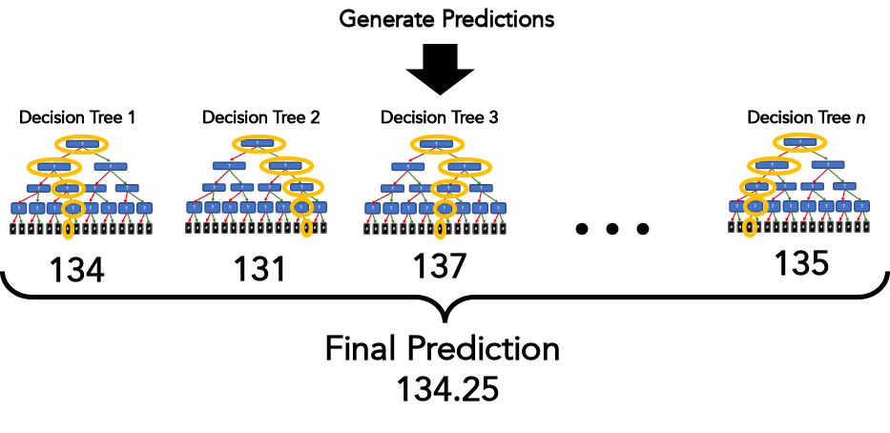
methodology : model training
Observed O-Ds
CBG
Dwelling Units
Building Area by Building Use
Other factors

Slide 9
initial results: existing conditions
Daily Boardings at Stations
Station | Actual (2019 Replica) | Predicted (Random Forest) | % diff
Miami | 1,184 | 1,172 | -1%
Fort Lauderdale | 1,214 | 1,108 | -8.7%
West Palm Beach | 394 | 405 | 2.8%
Total | 2,797 | 2,685 | -3.8%
Model prediction is good (shown in bold)
~3% total underprediction (to & from)
Station level varies
Give no ridership data from Brightline, this is great
Daily Alightings at Stations
Station | Actual (2019 Replica) | Predicted (Random Forest) | % diff
Miami | 1,206 | 1,191 | -1.2%
Fort Lauderdale | 1,316 | 1,209 | -8.1%
West Palm Beach | 275 | 311 | 13.1%
Total | 2,797 | 2,711 | -3.1%

Slide 10
intermediate results: new brightline stations
Daily Boardings at Stations
Station | Actual (2019 Replica) | Predicted (3 stations) | Predicted (5 stations)
Miami | 1,184 | 1,172 | 1,117
Aventura |  |  | 700
Fort Lauderdale | 1,214 | 1,108 | 950
Boca Raton |  |  | 507
West Palm Beach | 394 | 405 | 377
Total | 2,797 | 2,685 | 3,651
Daily Alightings at Stations
Station | Actual (2019 Replica) | Predicted (3 stations) | Predicted (5 stations)
Miami | 1,206 | 1,191 | 1,175
Aventura |  |  | 736
Fort Lauderdale | 1,316 | 1,209 | 1,022
Boca Raton |  |  | 499
West Palm Beach | 275 | 311 | 303
Total | 2,797 | 2,711 | 3,735
Jan 2023, Brightline released limited ridership data*. 156,137 monthly and 42,391 on ‘new stations’ i.e. Boca Raton and Aventura.
7,400 estimated vs 5,200 observed (+50%).
New v/s established stations issues
New stations constituted 27% ridership. Model was 33%
* https://emma.msrb.org/P21660034-P21277566-P21705591.pdf
Notes:
Data was 1-2 months after start

Slide 11
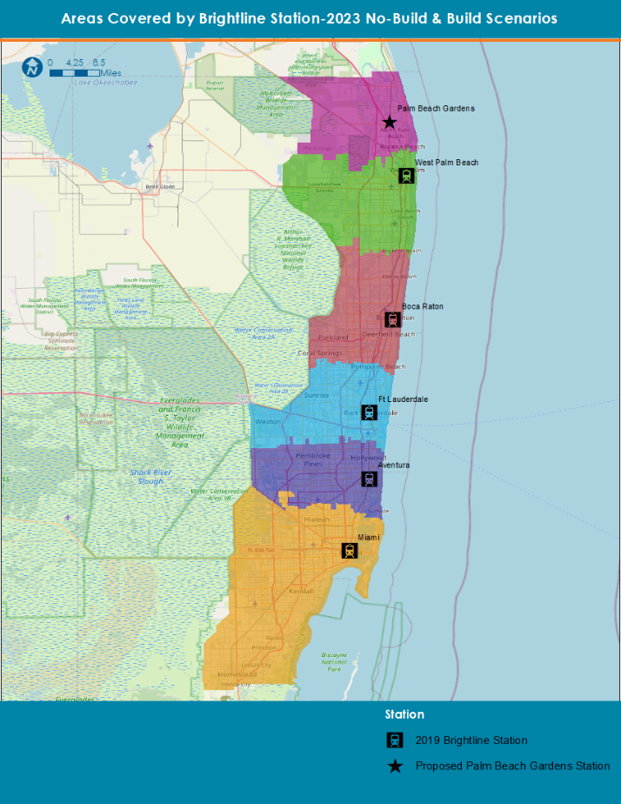
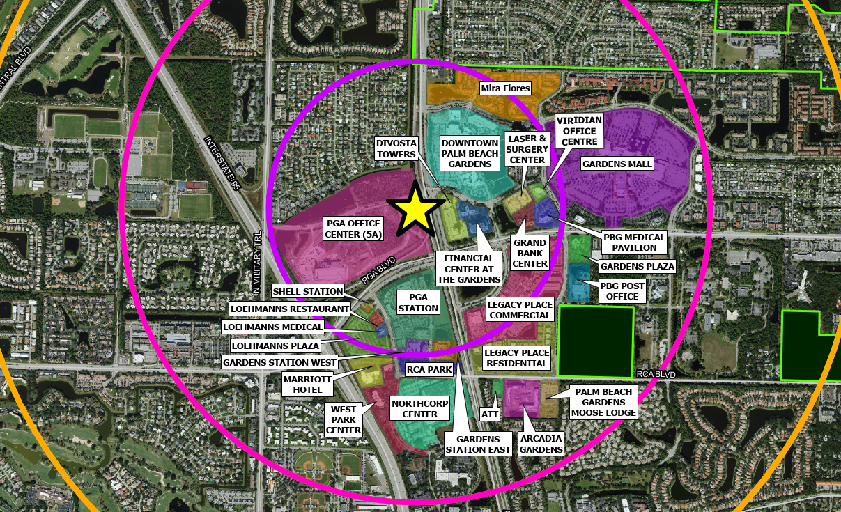
results: adding pbg station
Lots of stuff near the proposed station
Used their data

Slide 12
results: adding pbg station
Daily Boardings at Stations
Station | Predicted (5 stations) | Predicted (6 stations)
Miami | 1,117 | 1,190
Aventura | 700 | 746
Fort Lauderdale | 950 | 1,012
Boca Raton | 507 | 540
West Palm Beach | 377 | 330
Palm Beach Gardens |  | 255
Total | 3,651 | 4,074
Daily Alightings at Stations
Station | Predicted (5 stations) | Predicted (6 stations)
Miami | 1,175 | 1,246
Aventura | 736 | 781
Fort Lauderdale | 1,022 | 1,084
Boca Raton | 499 | 529
West Palm Beach | 303 | 267
Palm Beach Gardens |  | 251
Total | 3,735 | 4,158
If PBG station had existed in 2019, along with Aventura and Boca Raton, the total boarding and alighting at PBG station would have been ~500.

Slide 13
key factor: building use around stations
All stations except Palm Beach Gardens have a higher proportion of non-SFR building use within 5-mile radius.
This becomes more important when we see building distribution within 5-miles
Notes:
The closeness to the station and the landuse matters for sure
Sf way high across the board for PBG
MF and Retail/Office is a large portion of the less than 2 miles and really high in the 1 mile buffer
aggregated each building use by one-mile driving distance increments from Behzad’s sheet, and divided it by the total area of every census block group whose centroid is at one-mile driving increments from the station. That’s how I got percentage compositions per driving mile distance from each station except PBG.
For PBG, I used the Building use by census block group, and clipped them using 1 mile concentric rings up to 5 miles. Within each ring, I calculated the building use area, and divided it by the total area of that one-mile ring.

Slide 14
results: reasonableness check
Reasonableness Check
Station | Land Area in 1 Mile of Station (acres) | Station Activity from SERPM (Existing Pop + Emp) | Modeled Trips within 1 mi | Trips/1000 (Emp + Pop)
Miami | 1,710 | 118,443 | 302 | 2.5
Aventura | 1,825 | 42,947 | 74 | 1.7
Fort Lauderdale | 2,009 | 63,638 | 220 | 3.5
Boca Raton | 1,954 | 35,637 | 92 | 2.6
West Palm Beach | 1,426 | 41,455 | 83 | 2.0
Palm Beach Gardens | 2,006 | 23,145 | 54 | 2.3
When ridership from within 1-mile radius of the stations is compared to station activity in that area, the modeled trips from Palm Beach Garden station fall within the reasonable range observed in the rest of the system.

Slide 15

summary: thumbs up
Random Forest is a powerful method to provide reasonable and quick forecasts
Can be used where existing ridership is established enough to provide good ‘training data’ for the model
Useful for preliminary analysis.
Provides basis for additional analysis.
Not ideal for future conditions unless training data has attributes that can be forecasted into the future
Needs additional reasonableness checks
This Photo by Unknown Author is licensed under CC BY

Slide 16

Thank you Thank you Thank you Thank you
Rhett Fussell, PE
Rhett.Fussell@wsp.com

Slide 17
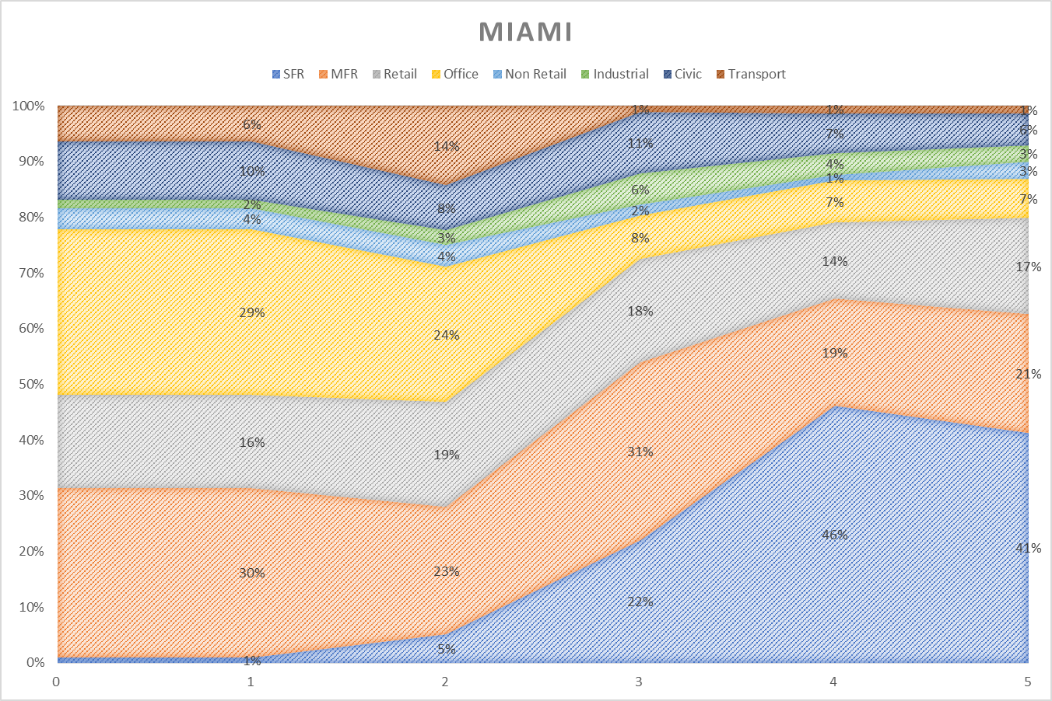
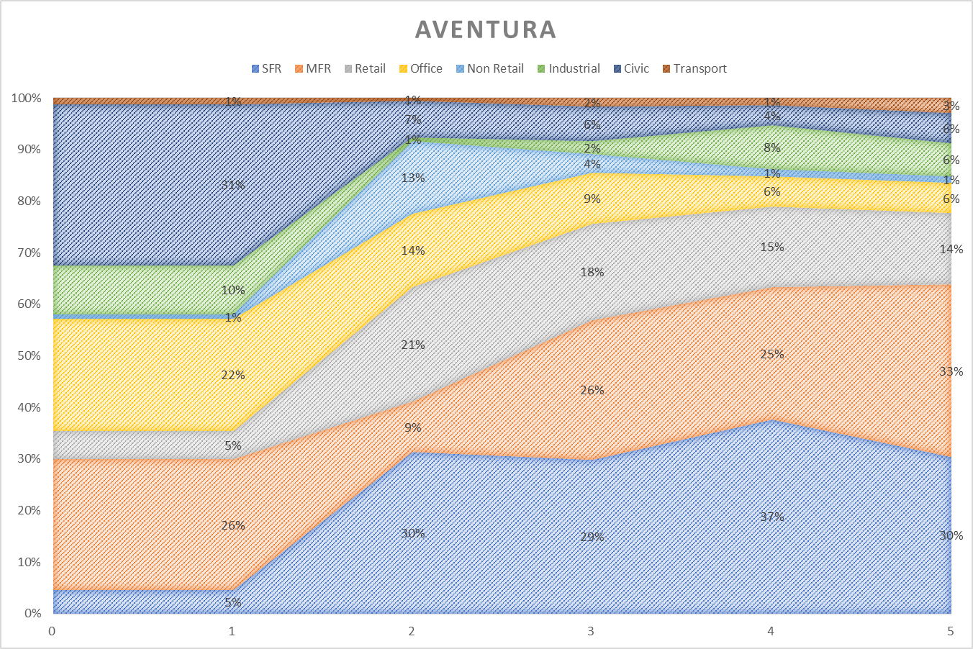
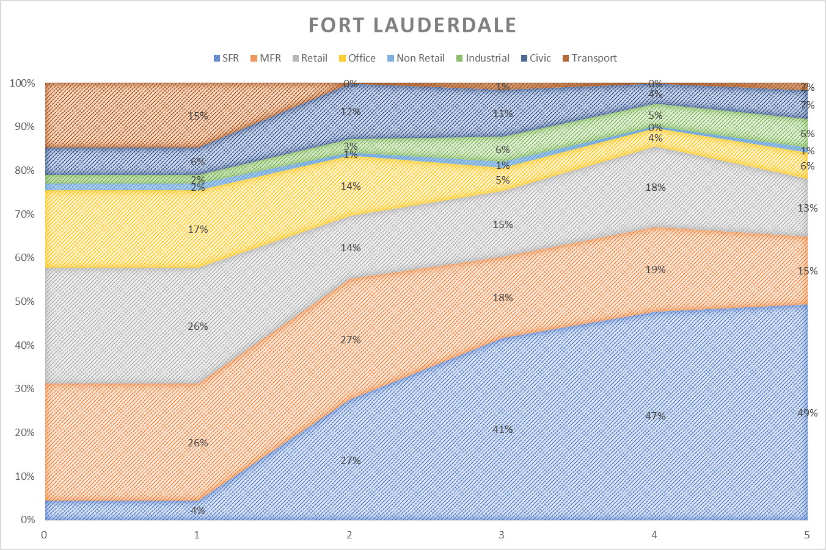
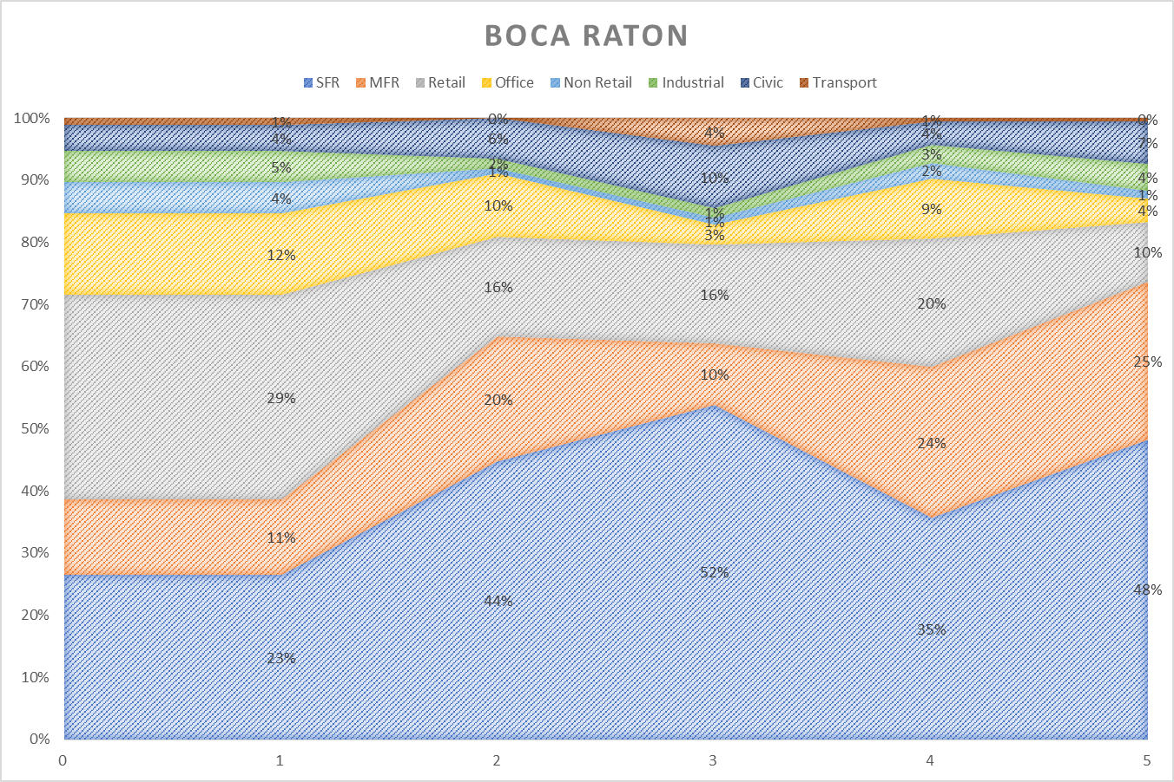
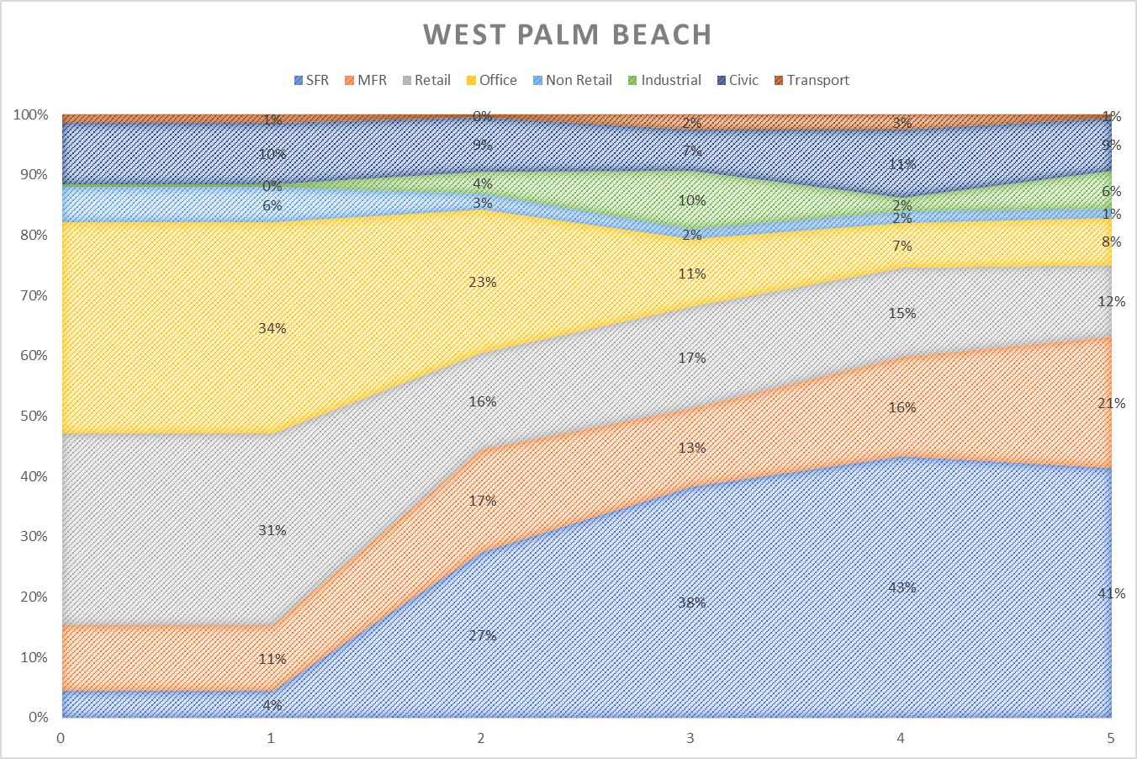
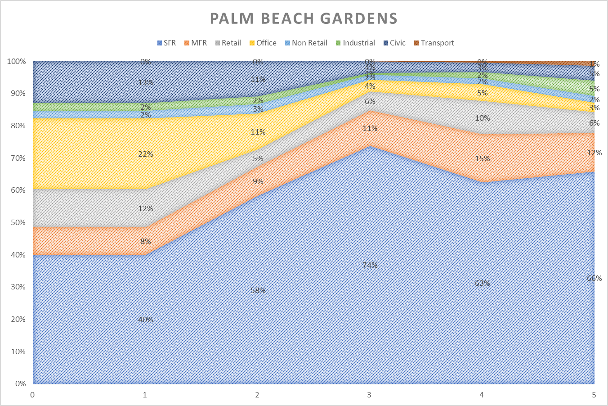
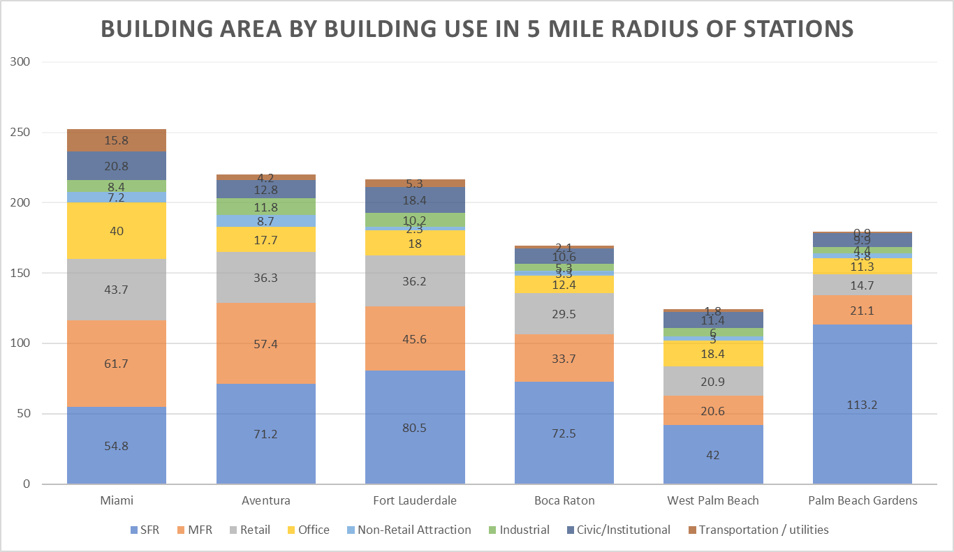
Key factor - building use round stations
Notes:
The closeness to the station and the landuse matters for sure
Sf way high across the board for PBG
MF and Retail/Office is a large portion of the less than 2 miles and really high in the 1 mile buffer
aggregated each building use by one-mile driving distance increments from Behzad’s sheet, and divided it by the total area of every census block group whose centroid is at one-mile driving increments from the station. That’s how I got percentage compositions per driving mile distance from each station except PBG.
For PBG, I used the Building use by census block group, and clipped them using 1 mile concentric rings up to 5 miles. Within each ring, I calculated the building use area, and divided it by the total area of that one-mile ring.

